Slide 1
NATURAL LANGUAGE PROCESSING IN SOCIAL MEDIA
Student’s Name: Naman Singhal
Section: G Course: B.Tech
Branch: CSE
University Roll no.: 2018953
Name of the mentor:
Kireet Joshi sir
Assistant Professor

Slide 2


INTRODUCTION
Sentimental analysis is a natural language processing text mining technique
that uses mathematics and other machine learning tools to determine
the emotional meaning of communications. Natural language processing is used
to determine sentiments of human understandable languages as a computer cannot understand human languages directly. Sentimental Analysis can be done using both supervised learning and unsupervised learning approaches. Supervised learning uses labelled data whereas unsupervised learning uses unlabeled data.
Machine learning is a very powerful method to analyse various situations. Some points to remember is:
Key aspects of a specific product and service that are important to customers.
Consumers intentions and reactions about those aspects.
Sentimental analysis is used in many domains like education, healthcare, various organizations etc. It is used to connect more strongly to the society and organizations. Most of the data is generated and extracted from social media for the studies as the social media acts as a huge pool of data and information for various studies and research that are going on.

Slide 3
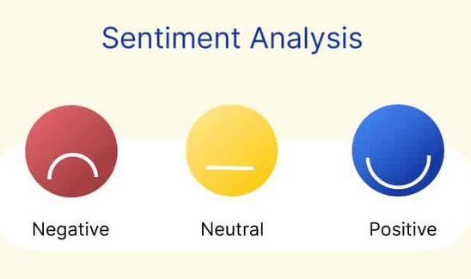
Natural language processing works on input and generates output after processing it and converting it into list of root words. It involves collecting data and then cleaning it using various tools to break into useful data for final result generation. While purchasing any product it is necessary to analyse whether that particular product meets the demand of the customer. Jupyter is an interactive platform for performing and analysing the sentiments in various regions easily.
Various modules of the python is imported like pandas, numpy, matplotlib.pyplot, seaborn etc. Word clouds which are a collection of words of various sizes are used for easy visualization which represent how frequently a particular word came or appeared in the tweets. Bilinear interpolation is used to plot graph and show relation between two labels or inputs X and Y label. The application of sentimental analysis are:
To recommend movies and books.
To conduct research in market places.
To know whether a customer liked a specific product.
To analyse the success rate of any campaign.
To identify the scope and performance of a product in market.

Slide 4


Problem Statement:
Sentimental Analysis using Python to determine the polarity and nature of tweets
data and classify them as Positive,Neutral or Negative??

Slide 5
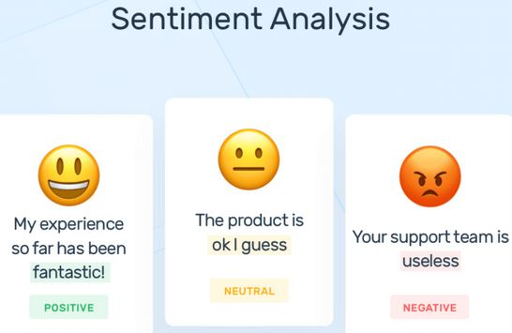

Slide 6

Methodology
The language that is used is Python and its libraries. This project is done on Jupyter notebook using the analysis of the data of 31k-41k tweets. As we cannot predict the sentiment directly using the tweets so converting them to other form and breaking them down is necessary. Now the biggest question that arises that how it works. So here is the stepwise procedure:
TOKENIZATION :
It means to break the sentence or paragraph into individual words and separate them
DATA CLEANING:
It means to remove special characters like @. from the given set so that we can work with main data words.
REMOVE THE STOP WORDS:
In this step, we have removed the words which do not contribute anything towards the analysis of sentiments . Here we have removed the popular conjunctions and interjections. We have finally kept those words with us that will be actually used in judging the sentiments of the tweets made and ignored other characters and words.

Slide 7

CLASSIFICATION AND SCORING:
Here we classify the words by assigning them a number 0,1 depending upon whether they are positive or negative respectively. Supervised learning algorithm for model training and to predict future work.
CALCULATION:
It is done to calculate the total and final score of the words that we got after collecting the and separating the words. Based on this final score we judge a particular tweet as positive, negative or neutral.
Various modules of the python is imported like pandas, numpy, matplotlib.pyplot, seaborn etc. The re module is to check for the similar patterns occurring in the data. The warnings which can be generated are ignored
using warning.filterwarnings(‘ignore’).Here only first five rows of the dataset has been shown for easy understanding. After collecting the tweets preprocessing is done to remove twitter handles and “@” symbols which will not contribute anything towards analysis of the sentiments of the tweets. Words whose length is not more than 3 are also ignored and removed because the do not reflect to any
sentiments. It is converted into Bag of words which represents the occurrence of a particular word. It does not takes into account the order in which each word occur.

Slide 8

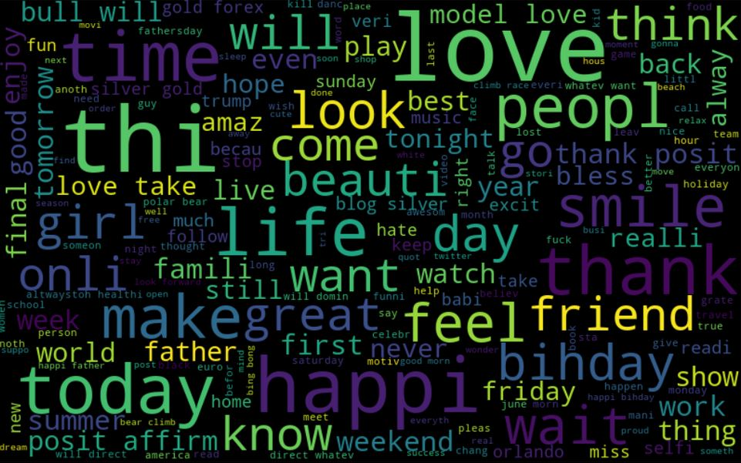
Then using split function, the finalized tweet is separated into list of individual words as we first need to convert it into list of elements to convert each word extracted into root or main word from which it is derived so that similar words come into same category and respond to one and same type of sentiment. Word clouds which are a collection of words of various sizes are used for easy visualization which represent how frequently a particular word came or appeared in the tweets.

Slide 9

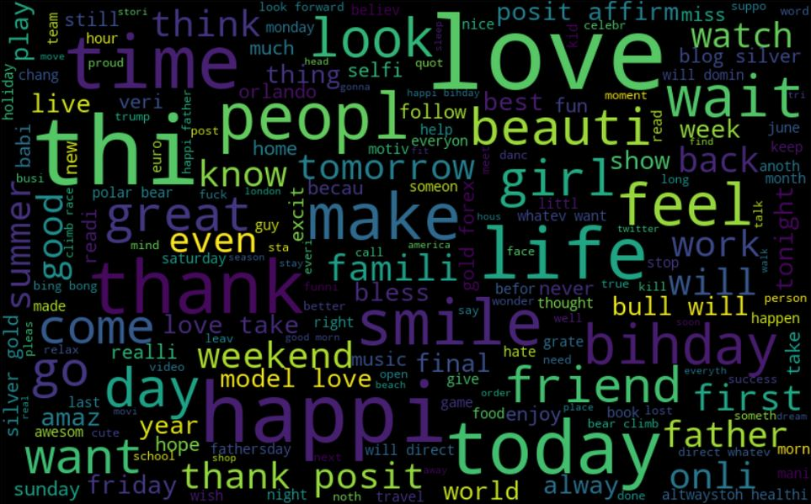
The words are generated using these word clouds which represents each root word in a particular size to show the occurrence of that particular root word in the tweets made by the people. Bilinear interpolation is used to
plot graph and show relation between two labels or inputs X and Y label. The height and the width of the wordcloud is specified according to the display size. Using word cloud those words are generated which are given 0 as positive label and 1 as negative label. The hashtags are extracted from non racist and racist words and displayed only first five data with their count that how many times that particular root word came up. Hashtags are represented as the list of keys of the tweet and the count is the corresponding value of that key and stored in the tokenized_tweet variable.

Slide 10

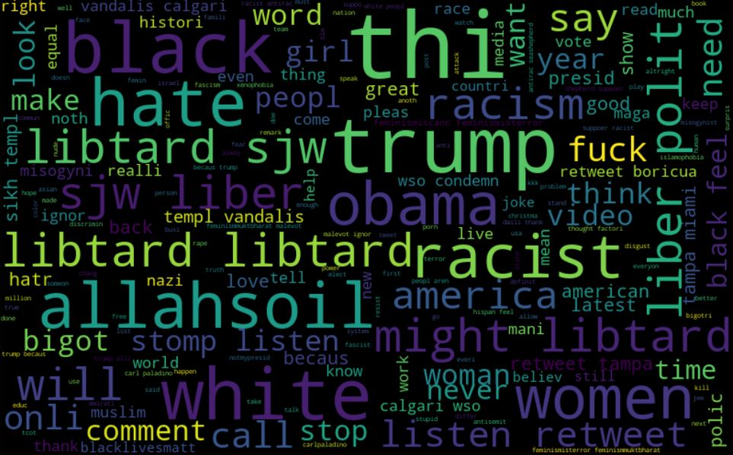
The graph shows the relation between the particular hashtag and its frequency of first the positive words and then of the negative hashtags. Through this, one can judge the sentiments of the tweets knowing the occurrence of each positive and negative words and then comparing the count from every graph. The dataset is split into X and Y label for training. Finally the accuracy of the model is predicted by importing accuracy_score from sklearn.metrics which help to predict the performance of a particular model or tool
Logistic Regression is used to predict the result using the previous information from data as the basis and generates a specific output unlike linear regression where the output is analyzed using equations and relationships among the different variables.

Slide 11

Result and Discussion
The sentiments of the tweets is successfully analyzed with 0.94 accuracy and finally the graphs are plotted between the root words extracted from the tweets and their count or the frequency. Various modules of the python is imported like pandas, numpy, matplotlib.pyplot, seaborn etc. The re module is to check for the similar patterns occurring in the data. The warnings which can be generated are ignored using warning.filterwarnings(‘ignore’).Logistic Regression is used to predict the result using the previous information from data. Using word cloud those words are generated which are given 0 as positive label and 1 as negative label.
The graph shows the relation between the particular hashtag and its frequency of first the positive words and then of the negative hashtags. The sentiments of the tweets is judged by knowing the frequency of each positive and negative hashtags and then comparing the count from every graph.

Slide 12
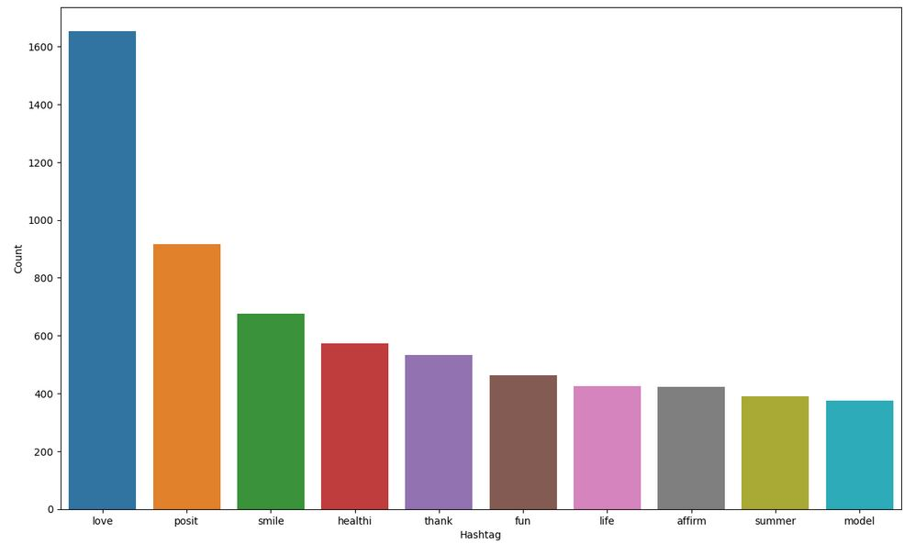

Slide 13
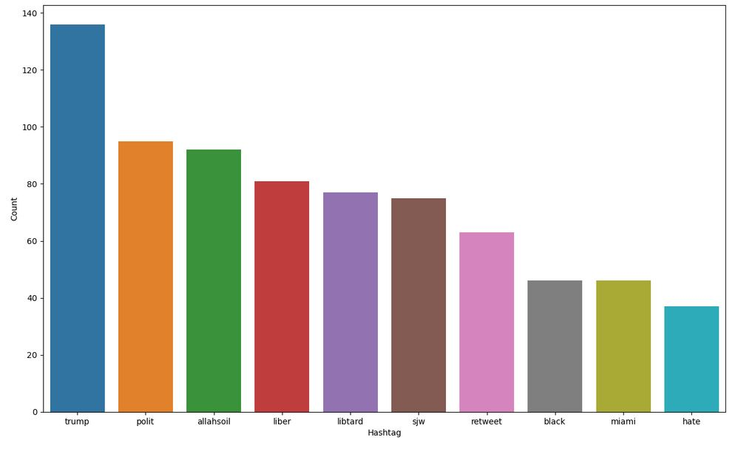

Slide 14

Conclusion and Future Work
The accuracy of the tweets analyzed is 0.94 which is successfully done on 31,962 tweets. The code is run on jupyter notebook which is an efficient platform for easy and smooth work. I have used logistic regression to predict that if in future more datasets need to be added then how accurately can it predict whether a particular tweet is positive or negative. For example if a data set is added having beautiful as one of the words then there are 94 percent chances that it will predict it as a positive word.
In future, I would like to increase and enhance my work in this domain to research more deeper regarding this particular topic by developing new tools that could better perform and is less time consuming than the present searches.
I would like to write my own research paper and add a more level towards development and technology.

Slide 15


